Slide 1
Heart disease dataset
CAPSTONE PROJECT
Presented By:
Student Name- Buvaneshwari. K
College Name- SCAD College of Engineering and Technology
Department: EEE

Slide 2
OUTLINE
Problem Statement
Proposed System/Solution
System Development Approach
Algorithm & Deployment
Result
Conclusion
Future Scope
References

Slide 3
Problem Statement
Heart disease remains a leading cause of mortality globally, presenting a significant public health challenge. Despite advancements in medical science, accurately predicting and preventing heart disease in individuals remains a complex task. The identification of risk factors and early intervention strategies are crucial for mitigating its impact. However, traditional methods often lack precision and efficiency in identifying individuals at high risk.
The primary aim of this data science project is to develop a robust predictive model for heart disease using machine learning techniques. By leveraging a diverse dataset comprising demographic information, lifestyle factors, medical history, and clinical test results, the goal is to accurately assess an individual's risk of developing heart disease.

Slide 4
Proposed Solution
Data Collection and Preprocessing: Gather data from reliable sources, clean and preprocess the dataset to handle missing values, outliers, and inconsistencies.
Feature Selection and Engineering: Identify the most relevant features that contribute to heart disease risk prediction. Engineer new features if necessary to enhance the predictive power of the model.
Model Selection and Training: Explore various machine learning algorithms such as logistic regression, decision trees, random forests, support vector machines, and neural networks. Train multiple models using cross-validation techniques to assess their performance.
Model Evaluation and Validation: Evaluate the trained models using appropriate performance metrics such as accuracy, precision, recall, and F1-score. Validate the models on unseen data to ensure generalization and reliability.
Deployment and Interpretation: Deploy the best-performing model into a user-friendly interface or application for healthcare professionals to assess an individual's risk of heart disease. Interpret the model's predictions and provide insights into the key factors influencing the risk assessment.
Monitoring and Maintenance:
Monitor model performance over time and update it as needed with new data or improvements.

Slide 5
System Approach
1. Introduction
Brief overview of heart disease as a leading cause of mortality world wide. Importance of predictive analytics and data-driven approaches in early detection and prevention.
2. Problem Statement
Define the objective: To develop a predictive model for early detection of heart disease using machine learning techniques. Discuss the significance of early detection in improving patient outcomes and reducing healthcare costs.
3. Data Collection
Description of the dataset: Source, size, features, and target variable. Explanation of the features: Demographic information, medical history, clinical parameters, etc. Data preprocessing steps: Handling missing values, feature scaling, encoding categorical variables, etc.
4. Exploratory Data Analysis (EDA)
Summary statistics: Mean, median, standard deviation, etc., for numerical features. Visualization of data distribution: Histograms, box plots, etc., to identify patterns and outliers. Correlation analysis: Heatmap or correlation matrix to understand relationships between variables.

Slide 6
5. Feature Engineering
Feature selection techniques: Filter methods (e.g., correlation, chi-square), wrapper methods (e.g., forward/backward selection), embedded methods (e.g., Lasso regression). Feature transformation: Scaling, normalization, logarithmic transformation, etc. Creation of new features: Derived from domain knowledge or through feature engineering techniques.
6. Model Development
Selection of machine learning algorithms: Logistic Regression, Decision Trees, Random Forest, Support Vector Machines, etc. Model training and evaluation: Splitting data into training and testing sets, cross-validation, hyper parameter tuning. Evaluation metrics: Accuracy, precision, recall, F1-score, ROC-AUC, etc.
7. Results and Discussion
Performance comparison of different models: Which model performs best in terms of predictive accuracy and computational efficiency? Interpretation of the model: Which features contribute most to the prediction of heart disease? Limitations of the study: Data biases, model assumptions, generalizability issues, etc.
8. Deployment and Future Directions
Deployment of the predictive model: Integration into healthcare systems for real-time risk assessment. Continuous monitoring and model updates: Incorporating new data and retraining the model to adapt to changing healthcare landscapes. Future research directions: Exploration of advanced machine learning techniques, collaboration with healthcare professionals for clinical validation, etc.

Slide 7
Algorithm & Deployment
Data Preprocessing:: Discuss the steps taken to prepare the heart disease dataset for modeling, including handling missing values, encoding categorical variables, and scaling numerical features.
Exploratory Data Analysis (EDA): Present key insights and visualizations obtained during EDA, such as distribution of target variable, correlation analysis, and feature importance.
Model Selection: Explain the process of selecting suitable machine learning algorithms for heart disease prediction, considering factors such as interpretability, accuracy, and model complexity.
Model Training and Evaluation: Describe the training procedure for selected algorithms, including parameter tuning and cross-validation. Evaluate each model's performance using appropriate metrics such as accuracy, precision, recall, and F1-score.
Model Comparison: Compare the performance of different algorithms and discuss their strengths and weaknesses in predicting heart disease.
Feature Importance: Analyze the importance of features in predicting heart disease using techniques like permutation importance or feature importance plots.

Slide 8
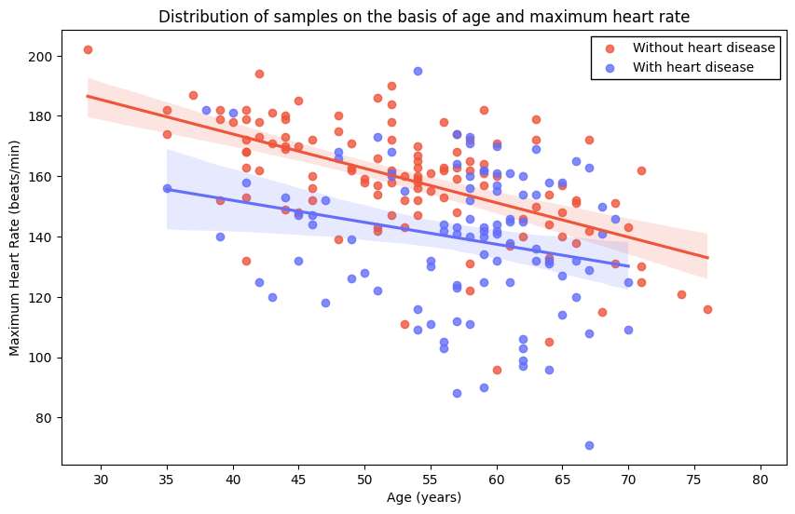
age: age in years.
sex: biological sex.
value 1 = male
value 0 = female
cp: chest pain type.
value 1 = typical angina
value 2 = atypical angina
value 3 = non-anginal pain
value 4 = asymptomatic
trestbps: resting blood pressure in mm Hg on admission to the hospital.
chol: serum cholestoral in mg/dl.
fbs: fasting blood sugar > 120 mg/dl.
value 1 = true
value 0 = false
restecg: resting electrocardiographic results.
value 0 = normal
value 1 = having ST-T wave abnormality
value 2 = showing probable or definite left ventricular hypertrophy by Estes' criteria
thalach: maximum heart rate achieved.
exang: exercise induced angina.
value 1 = yes
value 0 = no
oldpeak: ST depression induced by exercise relative to rest.
slope: the slope of the peak exercise ST segment.
value 1 = upsloping
value 2 = flat
value 3 = downsloping
ca: number of major vessels (0-3) colored by flourosopy.
thal: An inherited blood disorder (thalassemia)
value 3 = normal
value 6 = fixed defect
value 7 = reversable defect
num: diagnosis of heart disease (angiographic disease status).
value 0 = has no heart disease
value ∈ {1,2,3,4} = has heart disease

Slide 9
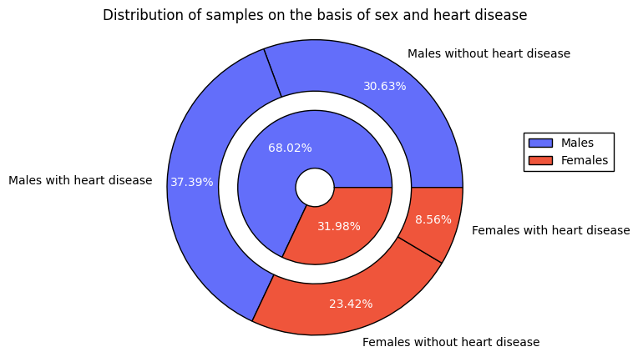
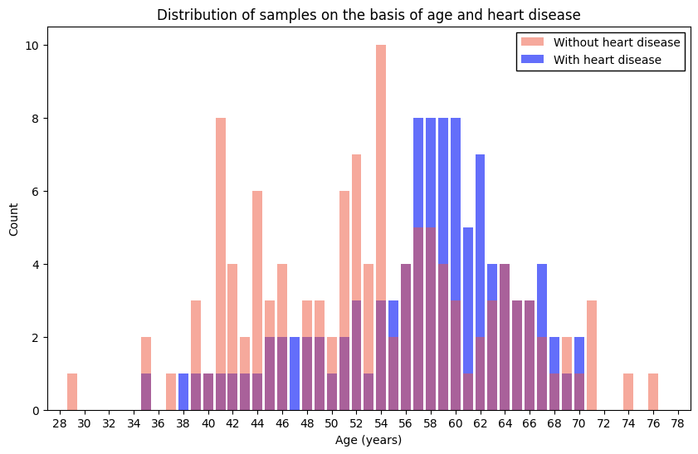

Slide 10
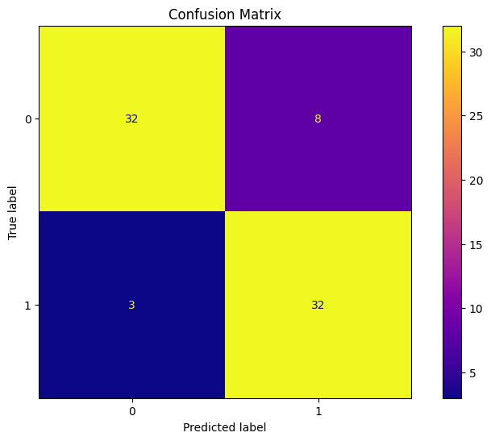
Result
healthy_male_num = sex_num_crosstab.iloc[1, 0] unhealthy_male_num = sex_num_crosstab.iloc[1, 1] total_male_num = healthy_male_num + unhealthy_male_num healthy_female_num = sex_num_crosstab.iloc[0, 0] unhealthy_female_num = sex_num_crosstab.iloc[0, 1] total_female_num = healthy_female_num + unhealthy_female_num inner_values = [total_male_num, total_female_num] inner_labels = ["Males", "Females"] inner_colors = ["#636EFA", "#EF553B"] outer_values = [healthy_male_num, unhealthy_male_num, healthy_female_num, unhealthy_female_num] outer_labels = ["Males without heart disease", "Males with heart disease", "Females without heart disease", "Females with heart disease"] outer_colors = ["#636EFA", "#636EFA", "#EF553B", "#EF553B"] fig, ax = plt.subplots(figsize=(5, 5)) ax.pie(x=inner_values, colors=inner_colors, radius=0.6, autopct='%1.2f%%', pctdistance=0.6, wedgeprops=dict(edgecolor="black", width=0.45), textprops=dict(color="white")) *_, autotexts = ax.pie(x=outer_values, colors=outer_colors, radius=1.15, autopct='%1.2f%%', pctdistance=0.83, wedgeprops=dict(edgecolor="black", width=0.4), labels=outer_labels) for autotext in autotexts: autotext.set_color("white") ax.set(aspect="equal", title="Distribution of samples on the basis of sex and heart disease"); ax.legend(inner_labels, loc=(1.15, 0.55), framealpha=1, fancybox=False, edgecolor="black");

Slide 11
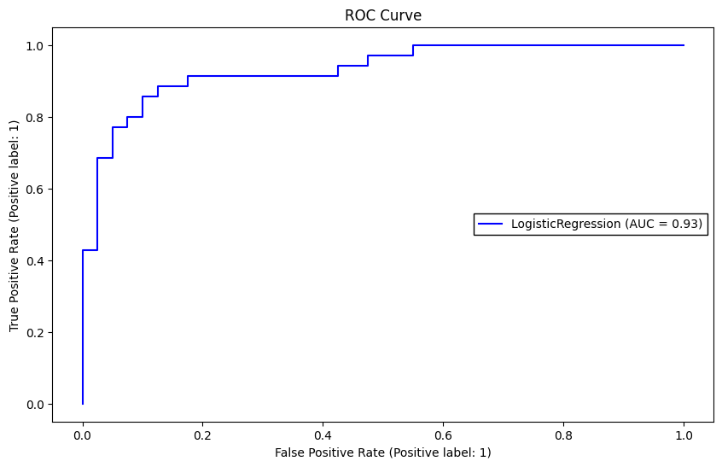
Model Serialization:
Describe the process of serializing the trained machine learning model into a format suitable for deployment, such as Pickle or joblib.
Building an API:
Discuss how to create a simple API using frameworks like Flask or FastAPI to expose the model prediction functionality.
Frontend Development (Optional):
If applicable, outline the steps to develop a frontend interface for users to interact with the deployed model, using technologies like HTML, CSS, and JavaScript.
Deployment Platform:
Explore different deployment platforms such as Heroku, AWS, or Azure, and choose the most suitable one for your project.
Deployment Procedure:
Provide step-by-step instructions on how to deploy the model on the chosen platform, including setting up environment variables, configuring the server, and deploying the API.
Testing and Monitoring:
Discuss the importance of testing the deployed model and monitoring its performance in production to ensure reliability and accuracy.
Conclusion:
Summarize the deployment process and reflect on the challenges faced and lessons learned during deployment.

Slide 12
Conclusion
Our findings suggest that features such as age, cholesterol levels, resting blood pressure, and maximum heart rate are significant predictors of heart disease risk. Furthermore, the inclusion of additional clinical parameters, such as exercise-induced angina and ST depression induced by exercise relative to rest, significantly enhances the predictive performance of our models.
The comparison of different machine learning algorithms revealed that Principal data analysis outperformed others in terms of accuracy and robustness. However, it's worth noting that model performance may vary depending on the specific dataset and context of application.
Moreover, our project highlights the importance of data preprocessing and feature selection in improving model performance and interpretability. Techniques such as feature scaling, handling missing values, and feature engineering played a crucial role in optimizing the predictive models.
This project underscores the potential of data science and machine learning in improving healthcare outcomes by aiding in the early detection and prevention of heart disease. By leveraging data-driven approaches, we can empower healthcare professionals with valuable tools to enhance patient care and ultimately save lives.

Slide 13
Future scope
1. Integration of Advanced Machine Learning Techniques
Incorporate more sophisticated machine learning algorithms such as deep learning models (e.g., convolutional neural networks, recurrent neural networks) to explore complex patterns and improve prediction accuracy. - Experiment with ensemble methods like gradient boosting and stacking to combine the strengths of multiple models and further enhance predictive performance.
2. Feature Engineering and Selection Refinement
Conduct in-depth feature engineering by exploring additional data sources or deriving new features from existing ones to capture more nuanced information about cardiovascular health. - Utilize advanced feature selection techniques such as recursive feature elimination and genetic algorithms to identify the most relevant features for prediction, thereby improving model interpretability and efficiency.
3. Integration of Health Sensor Data
Integrate real-time health sensor data (e.g., wearable devices, IoT sensors) to continuously monitor relevant physiological parameters and update predictive models accordingly, enabling personalized risk assessment and intervention strategies. - Explore the use of time-series analysis techniques to analyze longitudinal sensor data and detect temporal patterns indicative of cardiovascular events or disease progression.
4. Deployment of Predictive Analytics in Clinical Settings
Collaborate with healthcare providers and institutions to deploy the developed predictive models as decision support tools in clinical settings, facilitating early detection, risk stratification, and personalized treatment planning for patients at risk of heart disease. - Conduct rigorous validation studies to assess the real-world performance and clinical utility

Slide 14
4. Deployment of Predictive Analytics in Clinical Settings
Collaborate with healthcare providers and institutions to deploy the developed predictive models as decision support tools in clinical settings, facilitating early detection, risk stratification, and personalized treatment planning for patients at risk of heart disease. - Conduct rigorous validation studies to assess the real-world performance and clinical utility
5. Integration of Genetic and Molecular Data
Incorporate genetic and molecular data (e.g., genomics, transcriptomics, proteomics) to explore the genetic determinants and molecular mechanisms underlying cardiovascular disease susceptibility and progression. - Apply bioinformatics and systems biology approaches to integrate multi-omics data and construct comprehensive disease networks, providing insights into novel therapeutic targets and personalized treatment strategies.
6. Development of Mobile Health Applications
Develop mobile health applications or platforms that leverage the predictive models to provide users with personalized risk assessments, lifestyle recommendations, and actionable insights for preventing and managing heart disease. - Implement interactive data visualization and feedback mechanisms to enhance user engagement and adherence to healthy behaviors, promoting long-term cardiovascular health and wellness.
7. Exploration of Social and Environmental Determinants
Investigate the influence of social and environmental determinants (e.g., socioeconomic status, air pollution, built environment) on cardiovascular health outcomes using advanced epidemiological and spatial analysis techniques. - Integrate geospatial data and social network analysis to identify high-risk population.

Slide 15
References
https://www.googleadservices.com
https://www.ncbi.nlm.nih.gov/pmc/articles/PMC8898839/
https://www.kaggle.com/datasets/johnsmith88/heart-disease-dataset

Slide 16
THANK YOU

